Slide 1


The Hitchhiker’s Guide to the
DevOps
Zoran Krleža, IT Architect, RHCA
11.05.2022.

Slide 2
Contents
Introduction to the DevOps
Containers
Kubernetes and Openshift

Slide 3
Introduction to DevOps

Slide 4
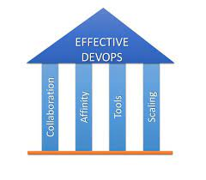
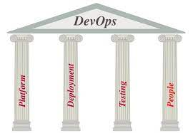
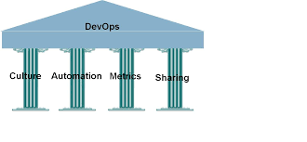
DevOps Principles and Pillars
Devops Pillars?
Collaboration, Affinity, Tools, Scaling
Platform, Deployment, Testing, People
Culture, Automation, Metrics, Sharing
Devops high-level Principles (6, 7, 9?):
Foster a Collaborative Environment (avoid blame culture, avoid silos)
Create With End in Mind (Organizations need to act similar to product companies)
Customer Centric Action (shorten feedback loops, place the client at the center)
Cross-Functional Autonomous Teams (T-shaped all-round skills profiles)
Automate (almost) Everything you can (automation is key to reducing software cycle times)
Encourage Continuous Improvement (continually improve pipelines, software, people and organization)
Embrace Failure (focus on learning from mistakes, not punishing for mistakes)
Unite Teams and Expertise (shared team visions and goals)

Slide 5

DevOps Engineer
A DevOps engineer introduces processes, tools, and methodologies to balance needs throughout the software development life cycle, from coding and deployment, to maintenance and updates.
DevOps Job Roles and Responsibilities:
DevOps Evangelist – The principal officer (leader) responsible for implementing DevOps
Release Manager – The one releasing new features & ensuring post-release product stability
Automation Expert – The guy responsible for achieving automation & orchestration of tools
Software Developer/ Tester – The one who develops the code and tests it
Quality Assurance – The one who ensures the quality of the product confims to its requirement
Security Engineer – The one always monitoring the product’s security & health
There’s no formal career track for becoming a DevOps engineer. They are either developers who get interested in deployment and network operations, or sysadmins who have a passion for scripting and coding, and move into the development side where they can improve the planning of test and deployment.

Slide 6
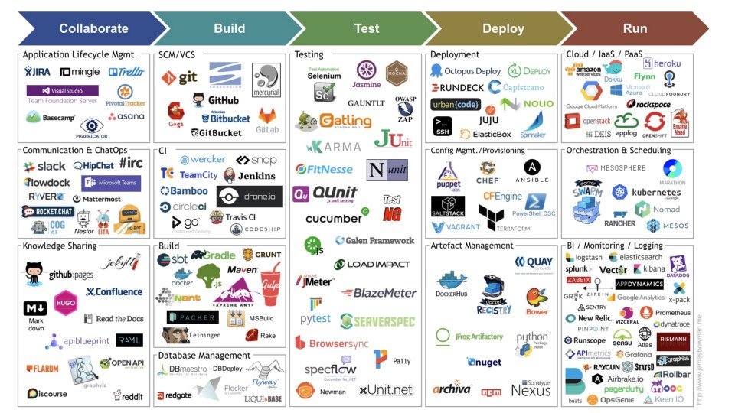
DevOps Tools

Slide 7
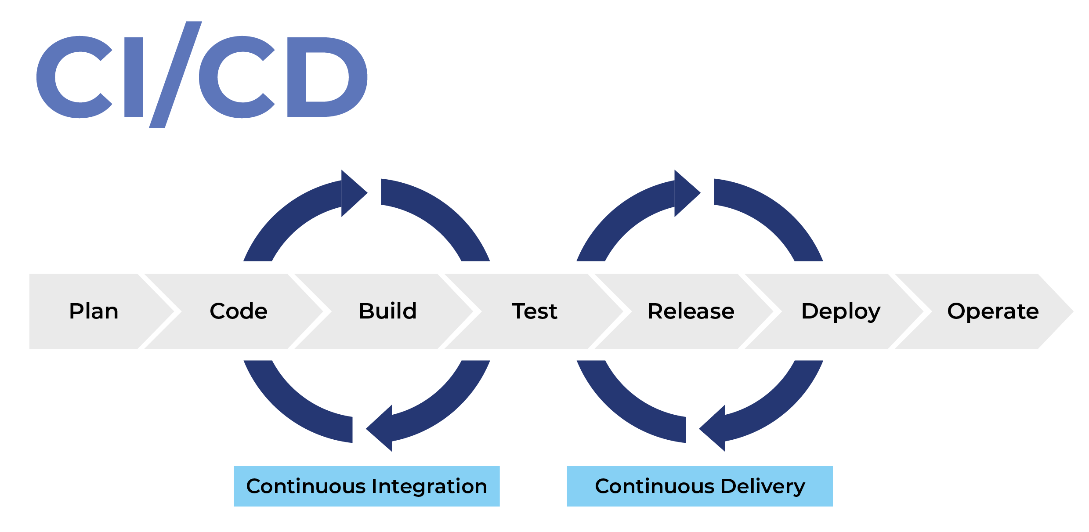
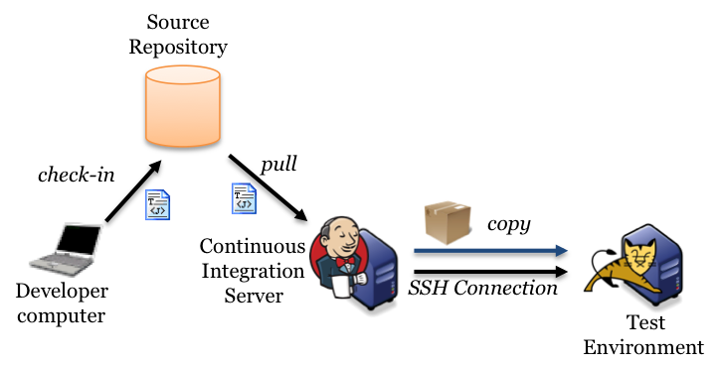
Continuous Integration / Continuous Delivery
Continuous Integration:
The process of integrating a new codebase with the master codebase frequently (in a day).
Long periods between merges result with more conflicts and effort when merging.
Bigger changesets make it more difficult to analyse and identify issues.
Build and automatic testing is usually triggered – concept of nightly builds.
Automatic test triggering ensures tests will not be skipped.
Often times performed by a same tool and as part of same process with Continuous Delivery.
Continuous Delivery:
Set of general software engineering principles that allow for frequent releases of new software through automated testing and continuous integration.
Continuous delivery ensures changes can be deployed. This can be ensured by deploying changes to a non-production environment on successful automated regression testing.
Usually manual testing prior to rollout to production.

Slide 8
Containers

Slide 9
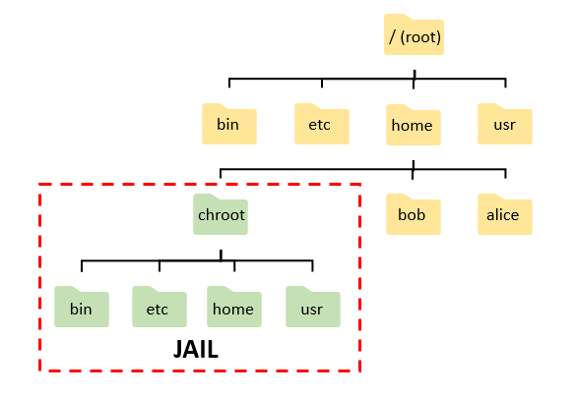
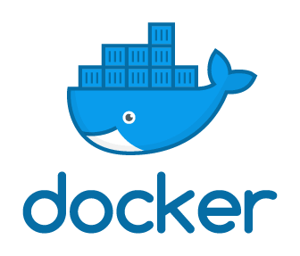


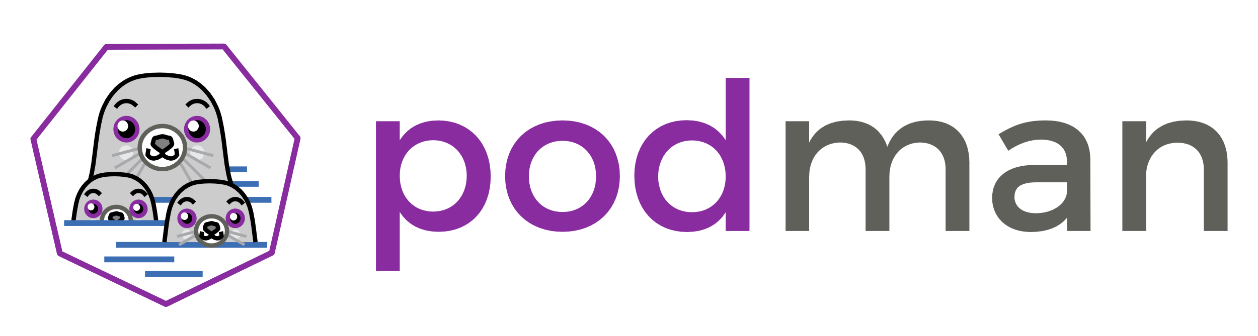

Container history
1979 – chroot – Linux command which changes the apparent root directory
2001 – Vmware ESX – Software virtualization
2007 – cgroups – Linux kernel feature that limits and isolates resource usage of processes
2008 – lxc – Linux Containers built on top of cgroups
2013 – Docker – First complete platform for containerization
2014 and beyond – Podman, Buildah, ContainerD, CRI-O, ...

Slide 10
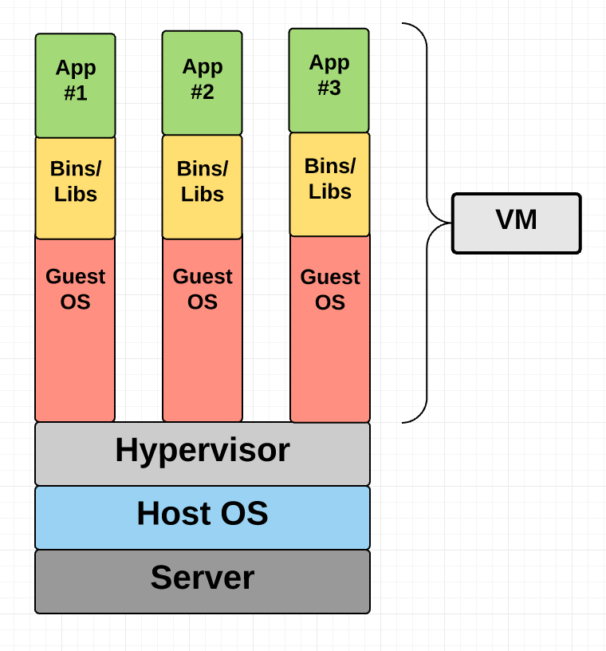
Virtual machines
An emulation of real computer as a virtual or software based resource.
Hypervisor – Operating system specifically designed to run virtual machines
Each virtual machine emulates hardware required to run an operating system (CPU, Memory, Input/Output units, etc.)
Operating system is installed in each virtual machine.
Pros:
Hard isolation between VMs and operating systems installed inside them
Cons:
Each VM is a separate resource with whole instance of OS which needs maintenance
Takes up a lot of resources (disk space, memory, …)
Longer provisioning times

Slide 11
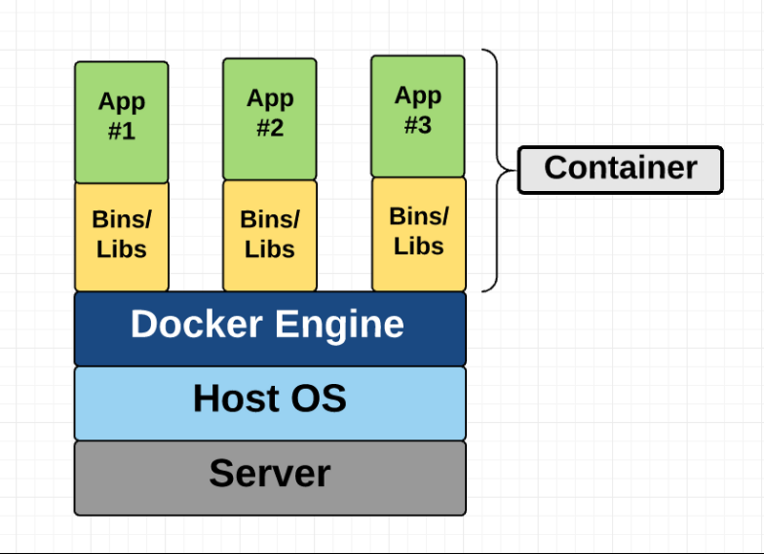
Containers
Operating system level virtualization.
Containers reside on one instance of operating system.
The isolation between them is implemented in container runtime engine (Docker, Podman, CRI-O, …).
Containers are instance of container images.
Pros:
Smaller footprint – contains only application with required dependencies
Faster provisioning and startup times
Container images are reusable
Cons:
Thinner isolation – applications share Host OS kernel

Slide 12
Container runtimes
Open Container Initiative (OCI) - provides a set of industry standards that define a container runtime specification and a container image specification. The image specification defines the format for the bundle of files and metadata that form a container image. When you build an application as a container image, which complies with the OCI standard, you can use any OCI-compliant container engine to execute the application.
Container Runtime Interface - a plugin interface which enables kubelet to use a wide variety of container runtimes, without the need to recompile. CRI consists of a protocol buffers and gRPC API, and libraries, with additional specifications and tools under active development

Slide 13
Container basics
Container Image – containes a packaged application, along with its dependencies and metadata
Container – running instance of an application packaged in container image (instance of container image)
Container Engine – OS level virtualization software which is responsible for running containers and providin isolation between them
Container Registry – a place to store container images (can be private or public)
https://hub.docker.com/
https://quay.io/
https://registry.access.redhat.com/

Slide 14
Container basics
Container Image – containes a packaged application, along with its dependencies and metadata
Container – running instance of an application packaged in container image (instance of container image)
Container Engine – OS level virtualization software which is responsible for running containers and providin isolation between them
Container Registry – a place to store container images (can be private or public)
https://hub.docker.com/
https://quay.io/
https://registry.access.redhat.com/

Slide 15
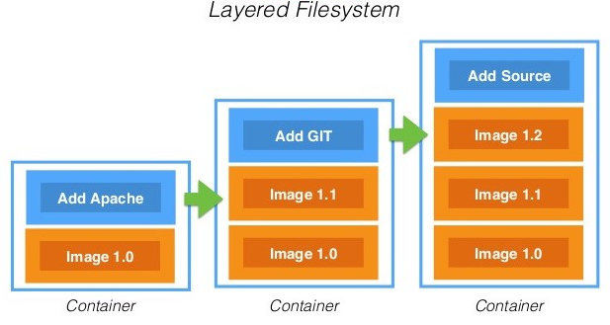
Container Image
Container image is built using a special file called Dockerfile or Containerfile
Containerfile contains a list of instructions which define how the image is built.
Container image uses a Layered FS to create container file system.
Building docker images can be triggered by running docker build command.
When a docker image is built it is stored in local filesystem storage.
This image can be tagged and pushed to a remote registry with docker tag and docker push command.
Dockerfile reference:
https://docs.docker.com/engine/reference/builder/
Containerfile
-------------------------------------
FROM nginx
COPY nginx.conf /etc/nginx/nginx.conf
COPY src /usr/share/nginx/html/

Slide 16
Container Image - LAB
Write a Dockerfile which builds a container image that serves a custom web page (index.html) using nginx.

Slide 17
Container Image – Useful commands
# Building container image named myimage with tag v1.0 from current directory
docker build -t myimage:v1.0 .
# Pulling image latest nginx from public registries
docker pull nginx
# Authenticating with quay.io public image registry
docker login quay.io
# Changing image name and tag
docker tag myimage:v1.0 quay.io/user_name/mynginx:v0.1
# Pushing local image to quay.io image registry
docker push quay.io/user_name/mynginx:v0.1
# List all local images
docker images -a
# Remove a local image
docker rmi myimage:v1.0

Slide 18
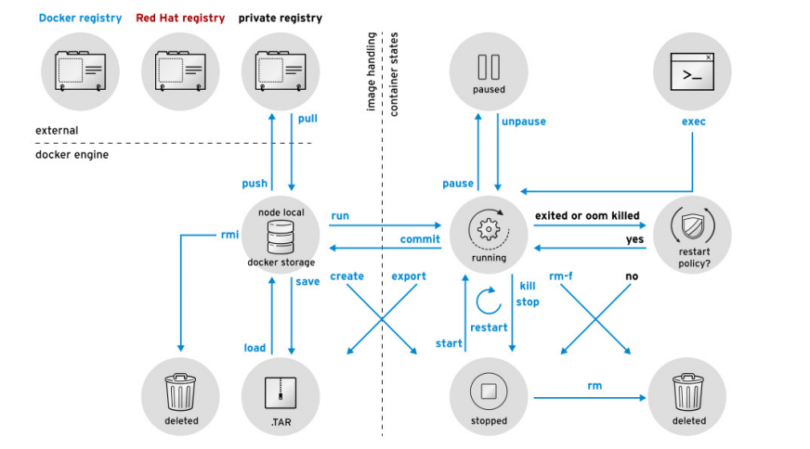
Running containers
Container is a running instance of container image.
It can be started with docker run command.
Container instance adds one r/w storage layer onto container image on which all operations are performed during the operation of container.
Allthough containers can be stopped and started again from that added storage layer, the basic nature of containers is ephemeral because that layer is present only locally.
When container is started from container image that is pulled from registry it doesn’t have that last “runtime” storage layer from previous runs.

Slide 19
Running containers – Useful commands
# Run a container in detached mode with name containername from image named myimage
docker run -d ––name containername myimage
# Run a container in interactive tty mode with name containername from image named myimage and start it by executing bash comand
docker run -it ––name containername myimage bash
# Examine logs from container named containername
docker logs containername
# Examine logs from container names containername and follow log output
docker logs -f containername
# Execute a bash command in container named containername in interactive tty mode
docker exec -it containername bash
# List running containers
docker ps
# List all containers (running and stopped
docker ps -a
# Stop container with name containername
docker stop containername
# Remove stopped container with name containername
docker rm containername

Slide 20
Running containers - LAB
Run a container in detached mode from image built in previous exercise. Give the container a meaningful name.
Examine the container logs.
Connect to container with docker exec command and examine the content of /usr/share/nginx/html.
Stop the container.
Run a new container from the same image but in interactive tty mode and override start command with bash.
Stop the container.
Remove all stopped containers.

Slide 21
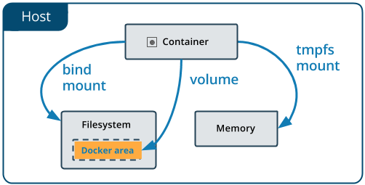
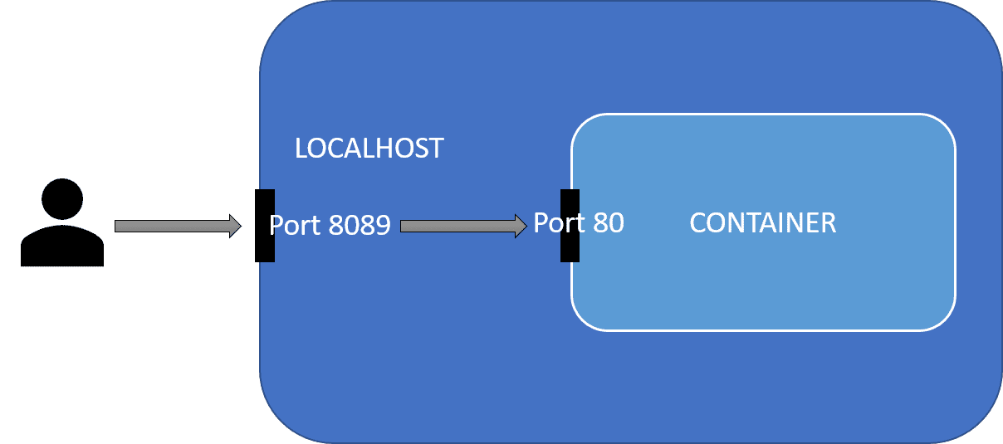
Container persistent storage and networking
To use persistency in containers, an external volume can be attached when starting container with the following command:
To expose application that is running inside a container on a specific port host port can be forwarded to the container port with the following command:

Slide 22
Container persistent storage and networking – Useful commands
# Run a container and bind host port 8080 to container port 80
docker run -d -p 8080:80 ––name containername mynginx
# Run a container and mount host folder /home/nexus/data in container to folder /nexus-data
docker run -d -p 8081:8081 -v /home/nexus/data:/nexus-data sonatype/nexus3
# Change the permission of folder to user:group:other = rwx:rwx:rwx
chmod 777 folder
# Change folder's user ownership to username and group ownership to groupname
chown username:groupname folder
# ONLY REDHAT DISTRIBUTIONS – Change folder’s SELinux context type to container_file_t
chcon -t container_file_t folder
# ONLY REDHAT DISTRIBUTIONS – Manage folder’s SELinux context type to container_file_t
semanage fcontext -a -t container_file_t '/home/user/data(/.*)?'
# ONLY REDHAT DISTRIBUTIONS – Apply managed SELinux context to /home/user/data
restorecon -Rv /home/user/data

Slide 23
Container persistent storage and networking - LAB
Run a container in detached mode from image built in the first exercise. Give the container a meaningful name and propagate host port 8080 to the container port 80.
Connect to the nginx web server with web browser.
Stop the nginx container.
Find sonatype/nexus3 container image on hub.docker.com
Start the nexus container in detached mode, map port 8081 on host to container port 8081 and mount container folder /nexus-data to a newly created folder on the host machine.
Connect to nexus with a web browser
Examine the host folder that is mounted to the container.
Stop the nexus container
Remove all stopped containers.

Slide 24
Kubernetes and Openshift

Slide 25
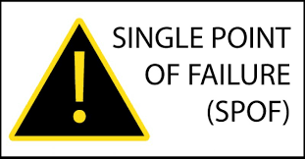
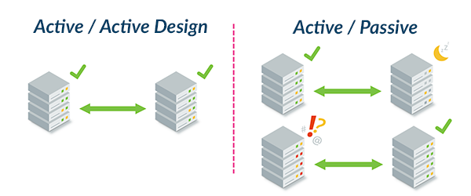
Kubernetes use-case
Problem:
Container is running on a single host or virtual machine.
This host / VM represents a single point of failure (SPOF).
If the host / VM crashes, the container crashes with it resulting in a service downtime.
Solution:
Create a container orchestration system which will provide high-availability of containers across multiple hosts / VMs.

Slide 26
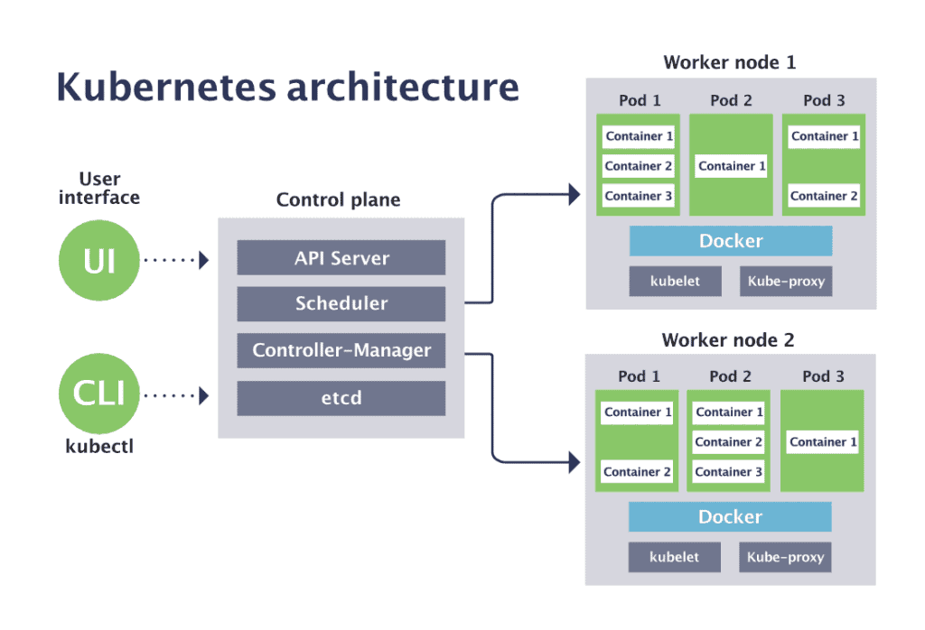
Kubernetes – container orchestration system
Kubernetes is a container orchestration system which provides following functionallities to containers:
High availability
Scalability
Automatic scheduling
Automatic restarting and health monitoring
Load balancing
Declarative deployment

Slide 27
Kubernetes architecture
Control plane
A group of management nodes which provides:
API Server – serves REST API interface for users to manage containers
Scheduler – takes care of container placement onto worker nodes
Controller-Manager – regulates the state of the cluster
etcd – key-value database which persists the cluster state

Slide 28
Kubernetes architecture
Worker nodes
A group of nodes used to run containers:
Kubelet – a node agent that manages the node and is responsible for issuing commands to container runtime
Container runtime – runtime for running containers (Docker, containerd, CRI-O, ...)
Kube-proxy – responsible for network management

Slide 29
Kubernetes Terms
Pod – Smallest deployable unit. Group of one or more containers with shared storage and network resources.
Deployment – Provides declarative definition of pods, its update strategy and management. Ususally create a ReplicaSet which guarantee the availability of a specified number of identical Pods.
StatefulSet - Similar to ReplicaSet but it is intended for stateful applications by providing guarantees about ordering and uniqueness of Pods. (sticky identity – replicas are ordered and numbered always in the same way)
DaemonSet – Similar to ReplicaSet but ensures that all Nodes run one replica of a Pod.
Service – An abstract way to expose an application running on a set of Pods.
Ingress – Object that manages external access to the services in a cluster.
ConfigMap – Object used to store non-confidential data in key-value pairs.
Secret – Object used to store confidential data in key-value pairs.
PersistentVolumeClaim – Object that define requests for persistent storage of an application.
PersistentVolume – Object that define a piece of storage in the cluster.

Slide 30
Managing Kubernetes
apiVersion: apps/v1
kind: Deployment
metadata:
name: webapp
spec:
selector:
matchLabels:
app: webapp
replicas: 2
strategy:
type: RollingUpdate
template:
metadata:
labels:
app: webapp
spec:
containers:
- name: webapp
image: nginx
ports:
- containerPort: 8080
name: http
Through CLI command kubectl
Most comprehensive
Well documented
Well structured – through YAML files
Through Web UI
Easy graphical management
No officiall web dashboards
Only subset of features

Slide 31
Kubernetes Lab

Slide 32
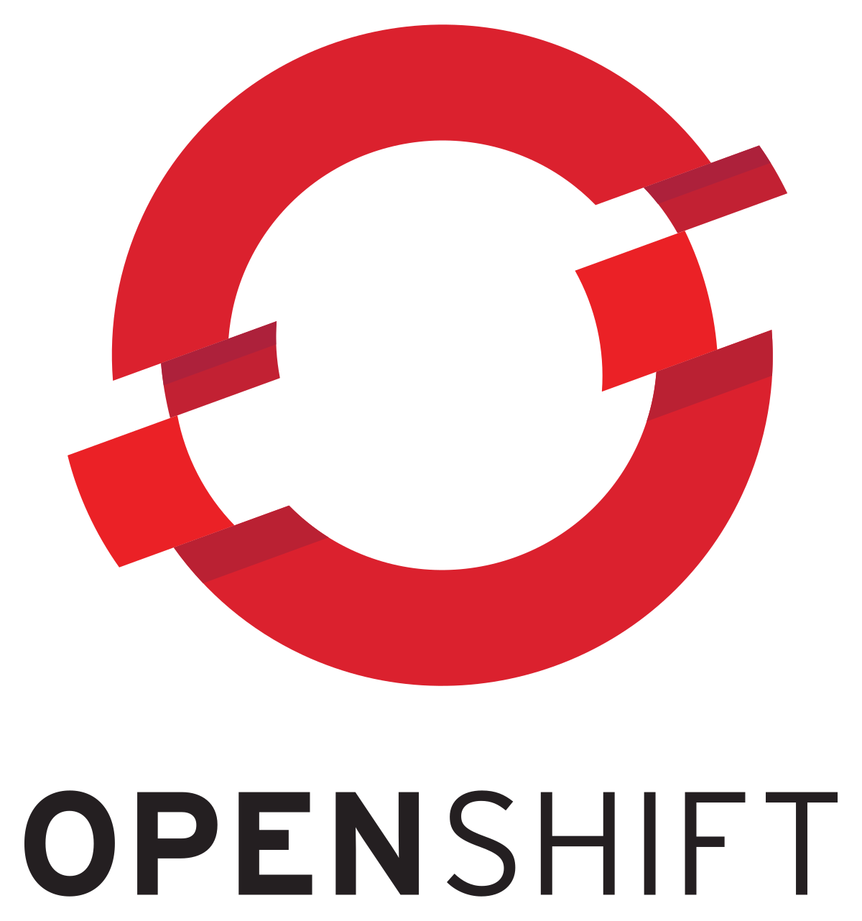
Openshift use-case
Problem:
Kubernetes is only orchestration system for containers without any additional services or functionalities like:
Comprehensive WEB interface for management
Logging and Monitoring
Development tooling
Integrated CI/CD pipeline tooling
etc
Solution:
Openshift is RedHat’s Kubernetes distribution which comes with a comprehensive set of integrated tooling.

Slide 33
Openshift showcase

Slide 34

Meet True North
True North Web Page
Careers @ True North
Notes:
And that’s what we’ve built – a new type of business partner for clients like you. We re IBM iX – a global business design partner. We believe that businesses need to be redesigned, not simply amplified with new messages or better ads - requiring holistic thinking around solving business problems. We help our clients imagine how their businesses will shape the world for years to come – then we make it real. Nothing we do is hypothetical. Everything we do has measurable impact.

Slide 35


